Slide 1
Introduction:
Exposition Park Neighborhood
University of Southern California| Rose Garden, Natural History Museum| Los Angeles Coliseum

Slide 2
Entrance
August 2013
Public transportation
Laundromat visits
Walking
Shopping at local stores

Slide 3
The Fall:
Reality of Los Angeles
Conversation with Clandestino: Adam & Eve

Slide 4
Exodus:
Reality of an Oppressed People
Conversation with Sr. Robles: Work Conditions

Slide 5
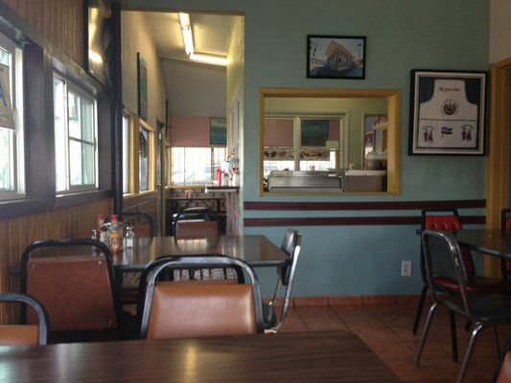
Exile:
The Wounds of a Displaced People
Conversation with Yessenia: story about El Salvador

Slide 6
“A transformational conversation is when a city conversation engages the God conversation resulting action for change.”

